Slide 1
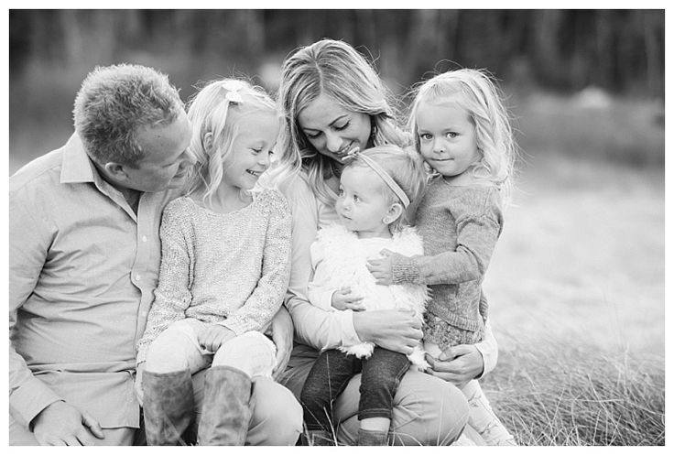


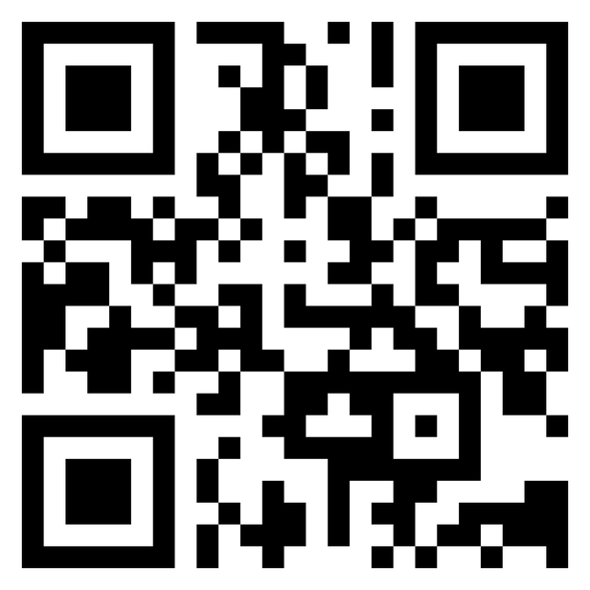
Team 29: Jam Pom
Notes:
Pau 1 min – Slide 1-3
JJ 1.5 min – Slide 4-10
Adih 30s – Slide 11
Thala 30s – Slide 12
Morta 30s – Slide 13
Min 1min – Slide 14-19

Slide 2


Problem Statement : a baby change their size so fast
Who is shopping for clothes the most?
Notes:
Problem statement:
> Before we start, our group would like to ask you some questions.
Whose family member in this picture do you think will buy clothes the most?
I believe that some of you might think it is the mother but
Actually, the answer is the baby

Slide 3

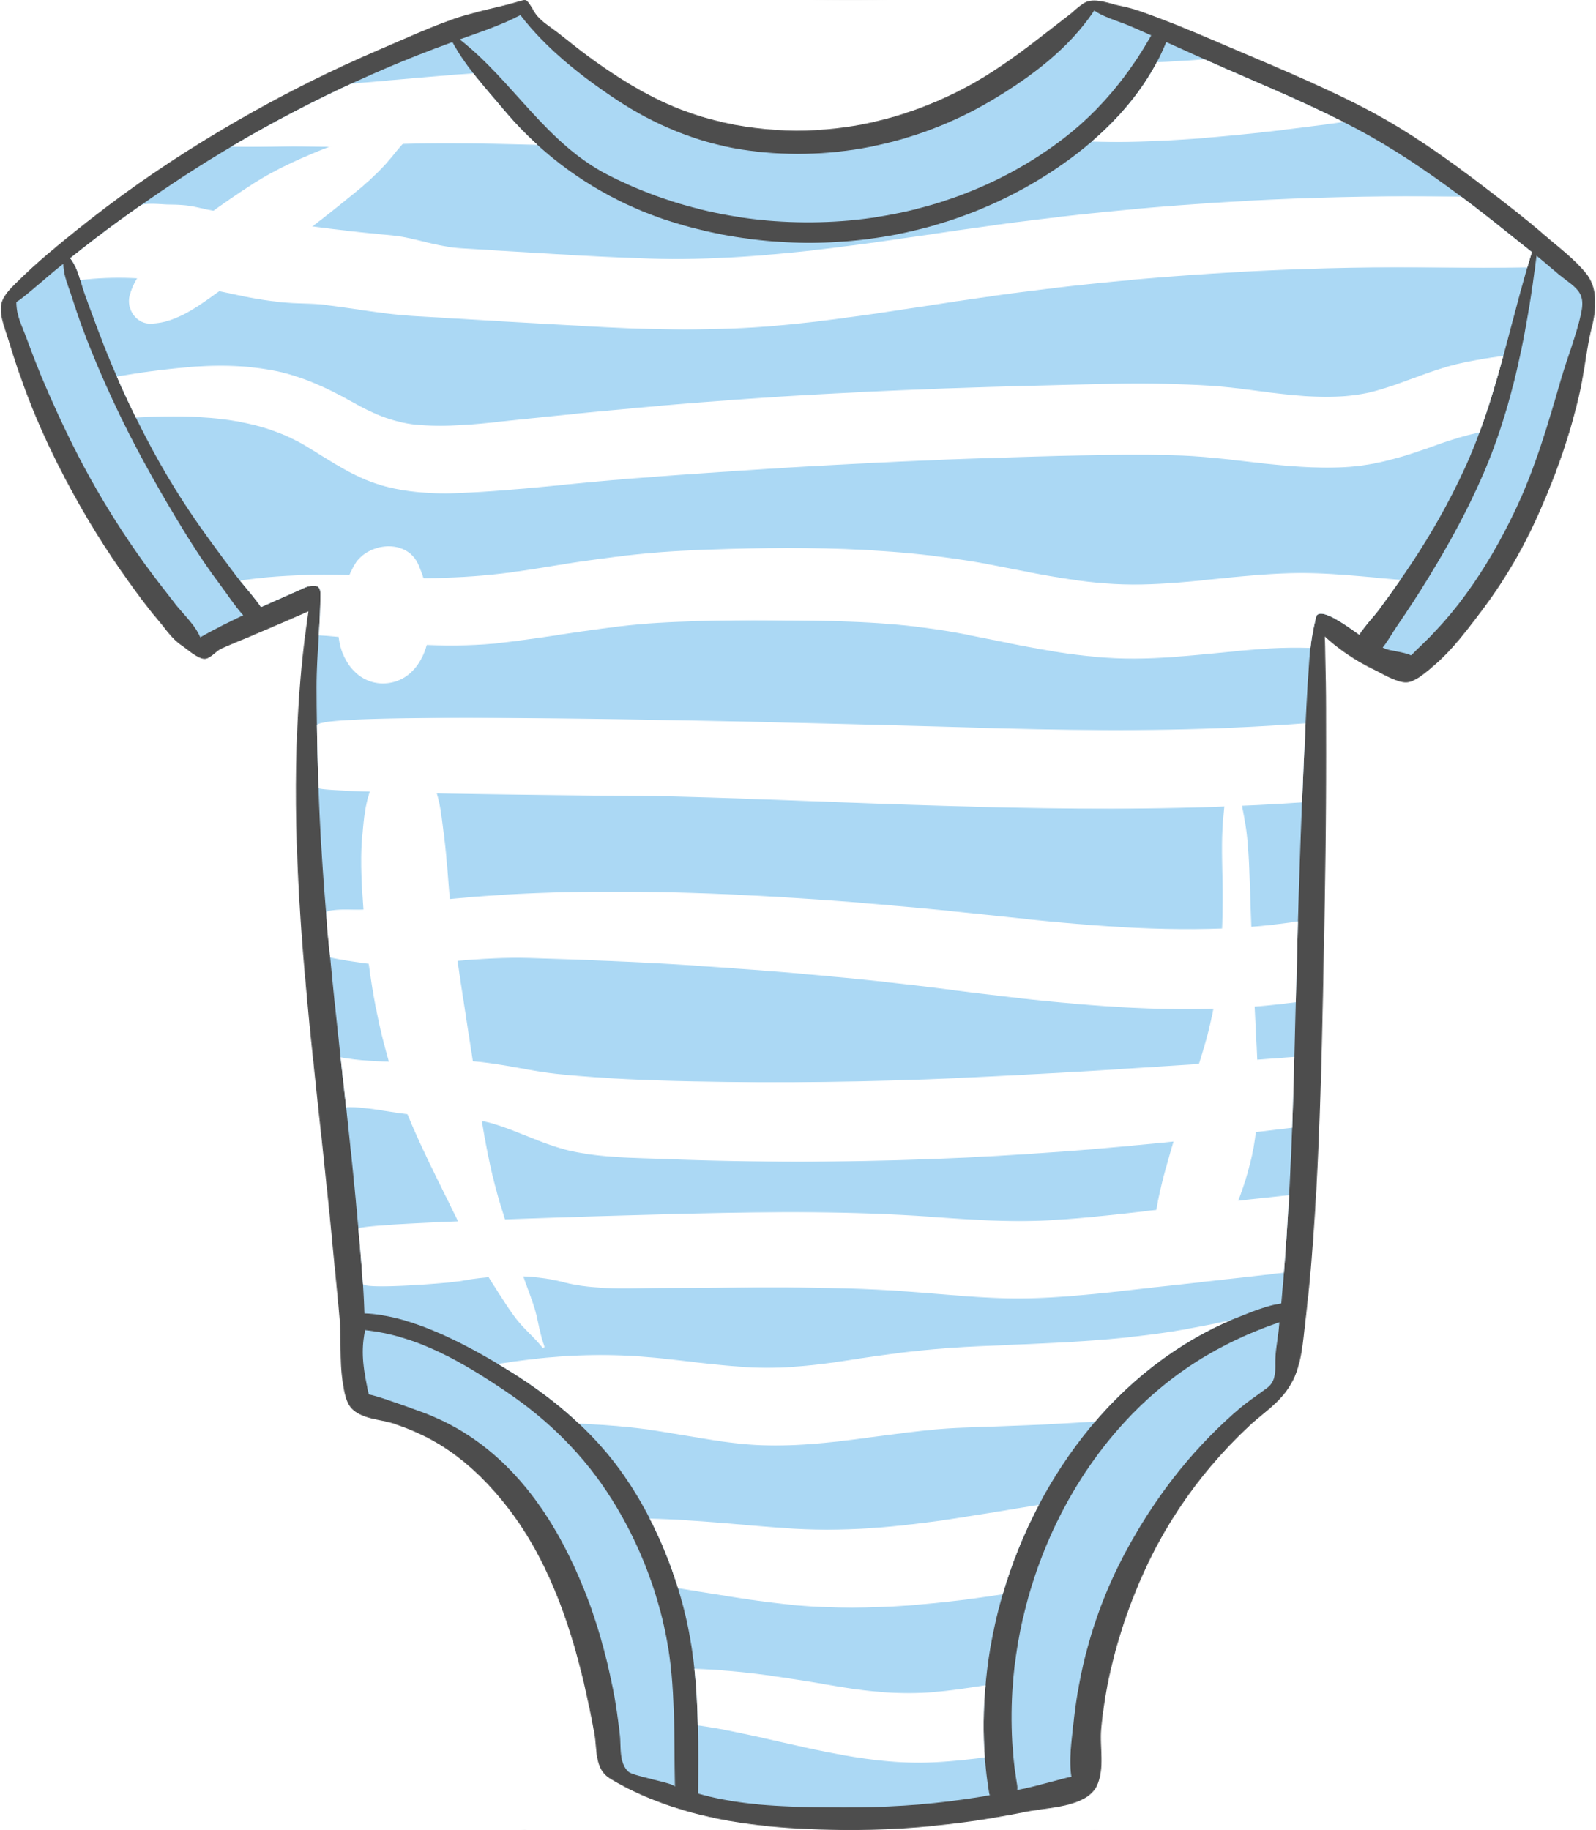

Problem statement : a baby change their size so fast
End up in wardrobe
56 +
Pieces per year
75%
Potential Demands
higher than the number from his mother
Notes:
According to statistics, the baby aged under 5 years will usually change their clothes size every 3 months.
Accounted for a total of 56 pieces per year or up to 75% higher than the number from women.
However, unfortunately these clothes usually end up in your wardrobe when the baby is growing up.
Leaving those thing become waste and inefficiently use the clothes
On the other hand, everyday there are also new parents that have to buy or want to get these clothes at the same time.
Therefore, Cutinues is created to connect these person together

Slide 4


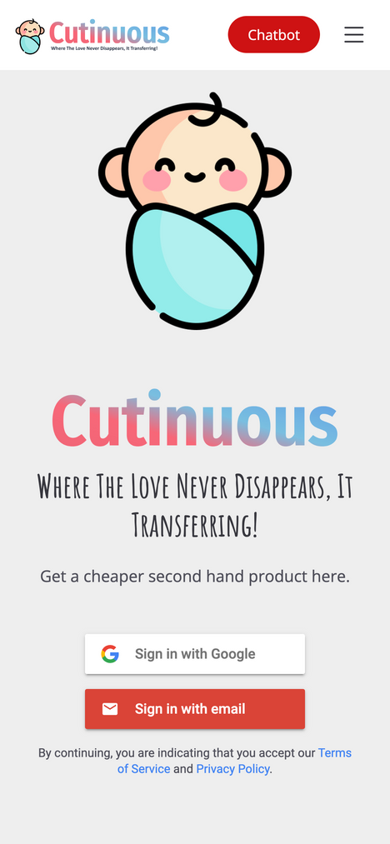
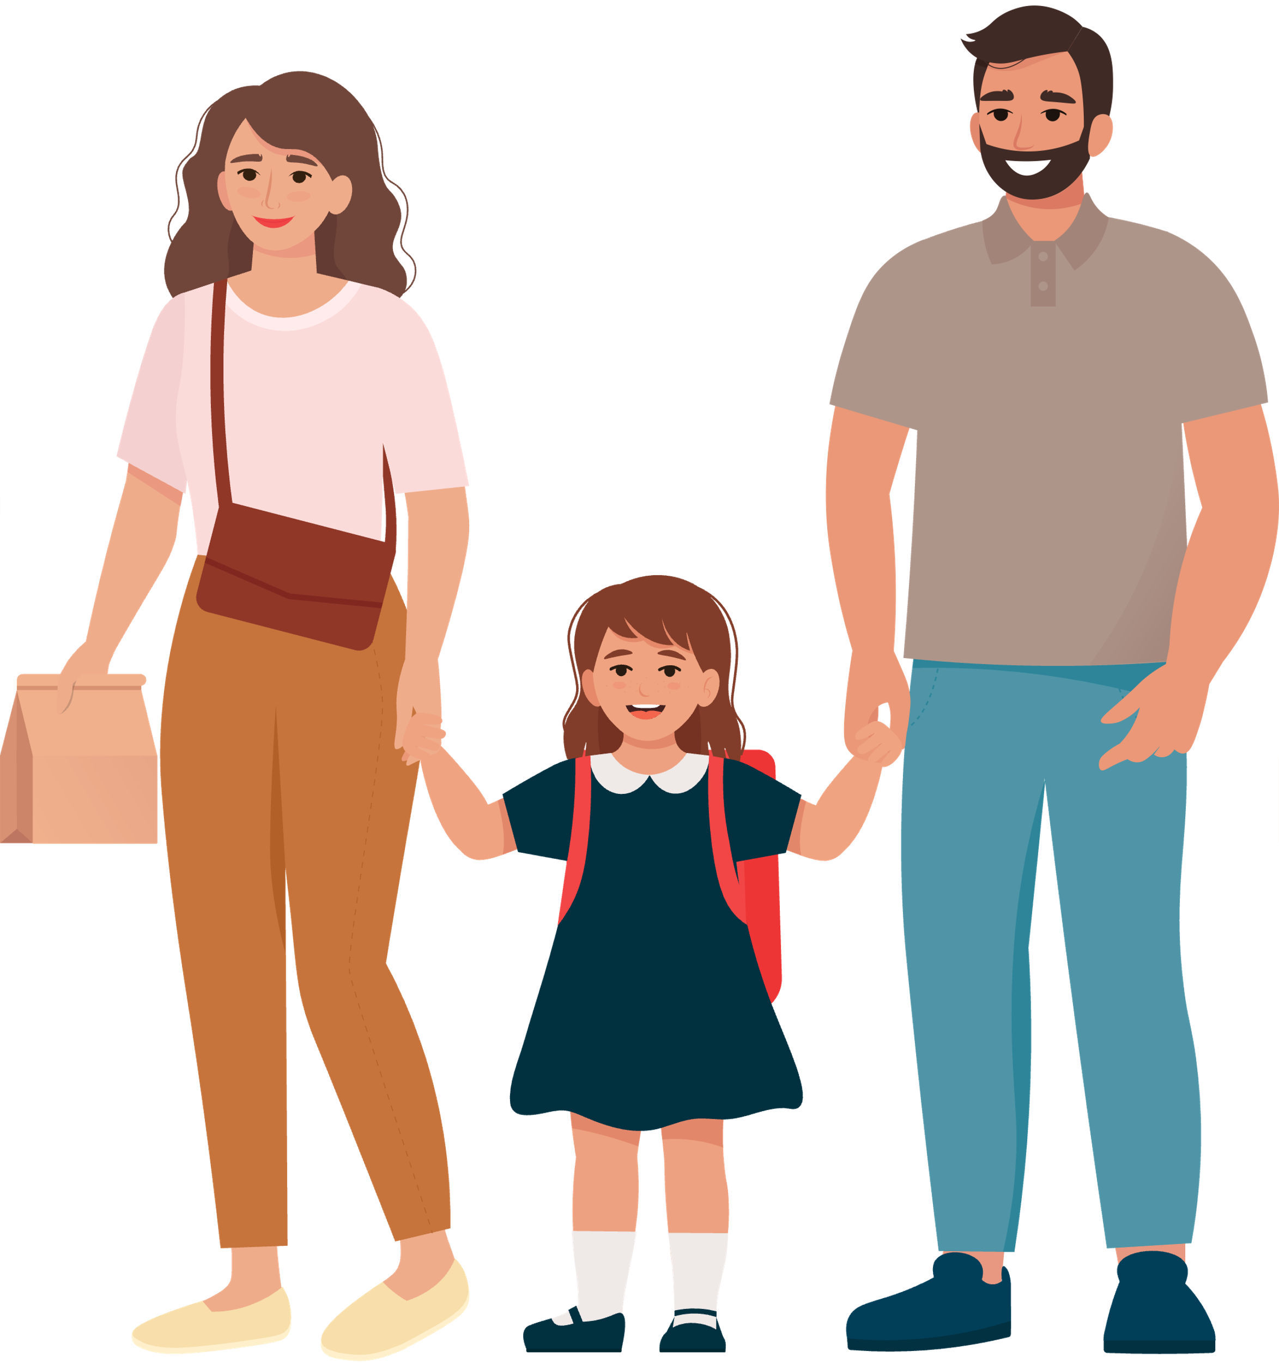
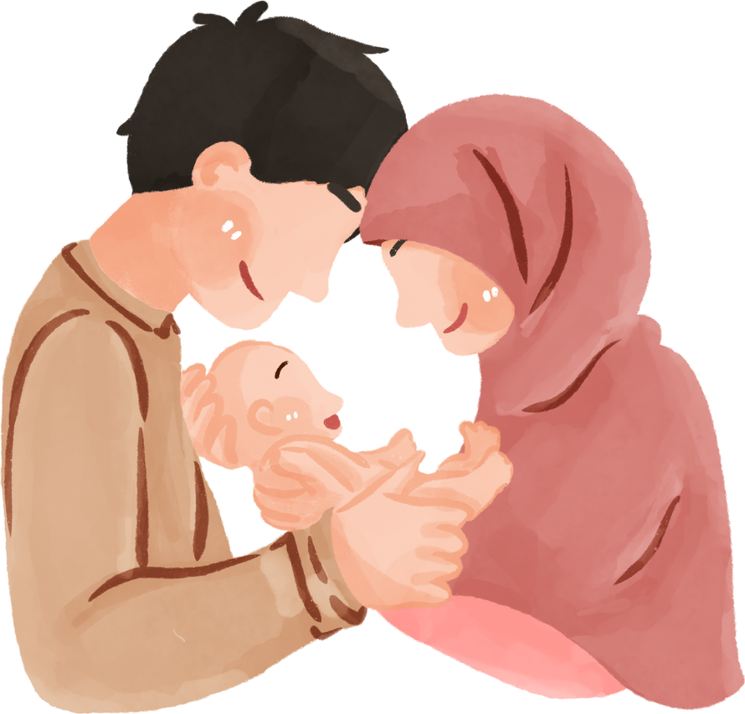
Solution : Concepts
Sell unused
shirt
I want
cheap shirt
Notification
Confirmation
Payment
Release money after settlement.
Notes:
Continuous is here to assist! Parents can post unused items for sale, while buyers can purchase second-hand goods. Owners receive notifications when someone is interested. Upon confirmation and payment from the buyer, owners can deliver the item. We release payment only after the buyer receives the product.

Slide 5

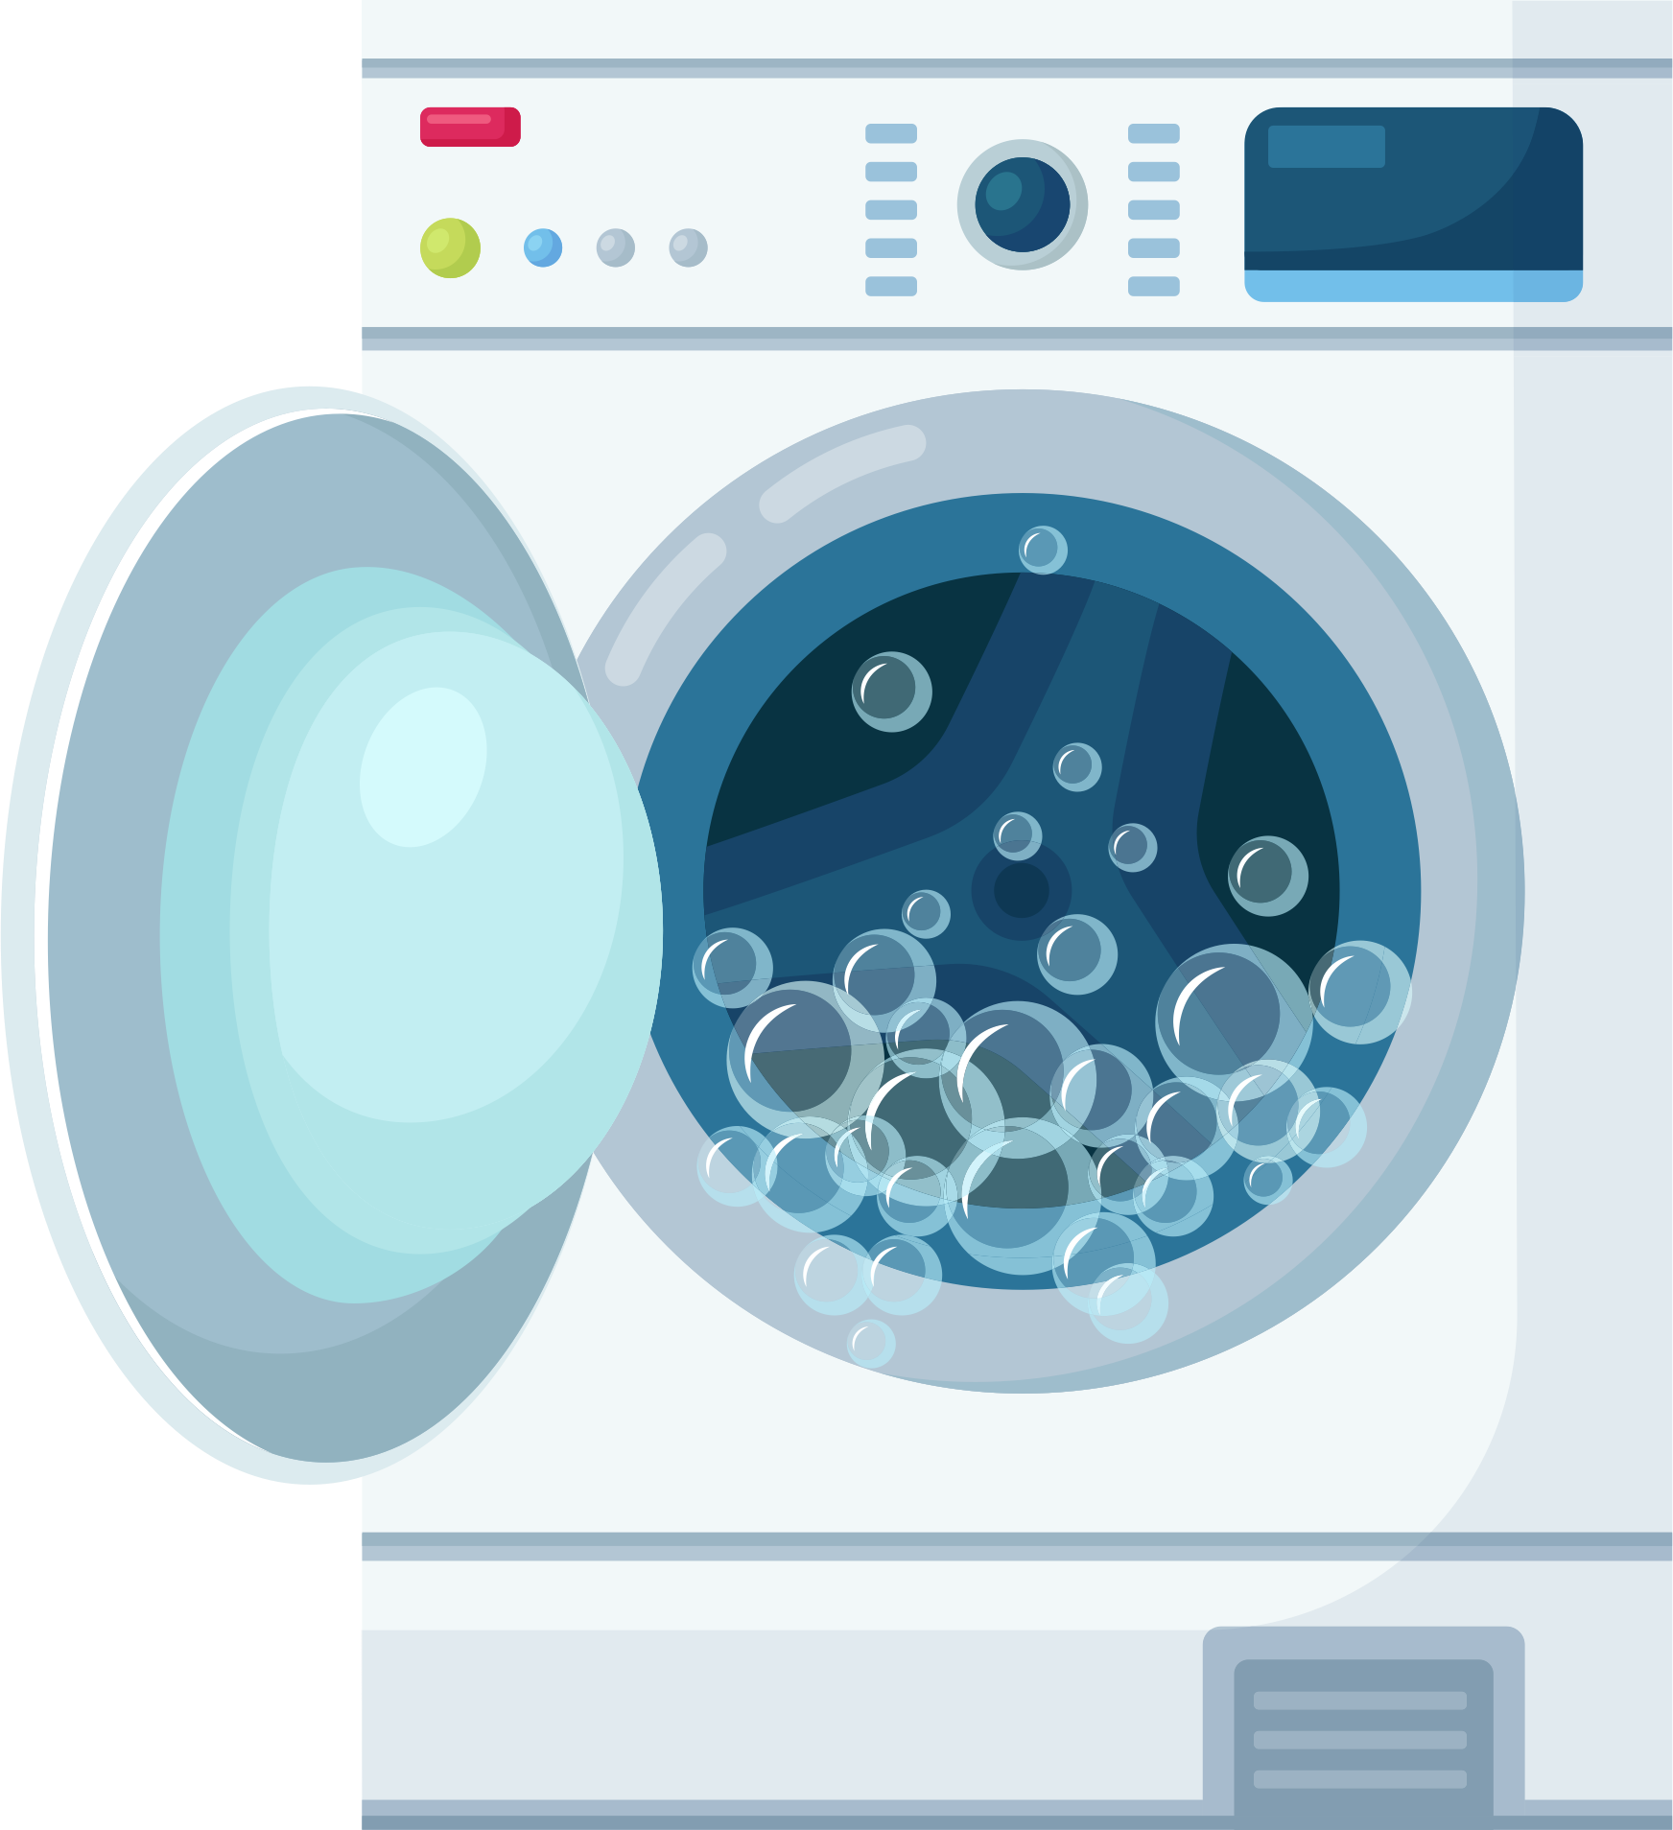
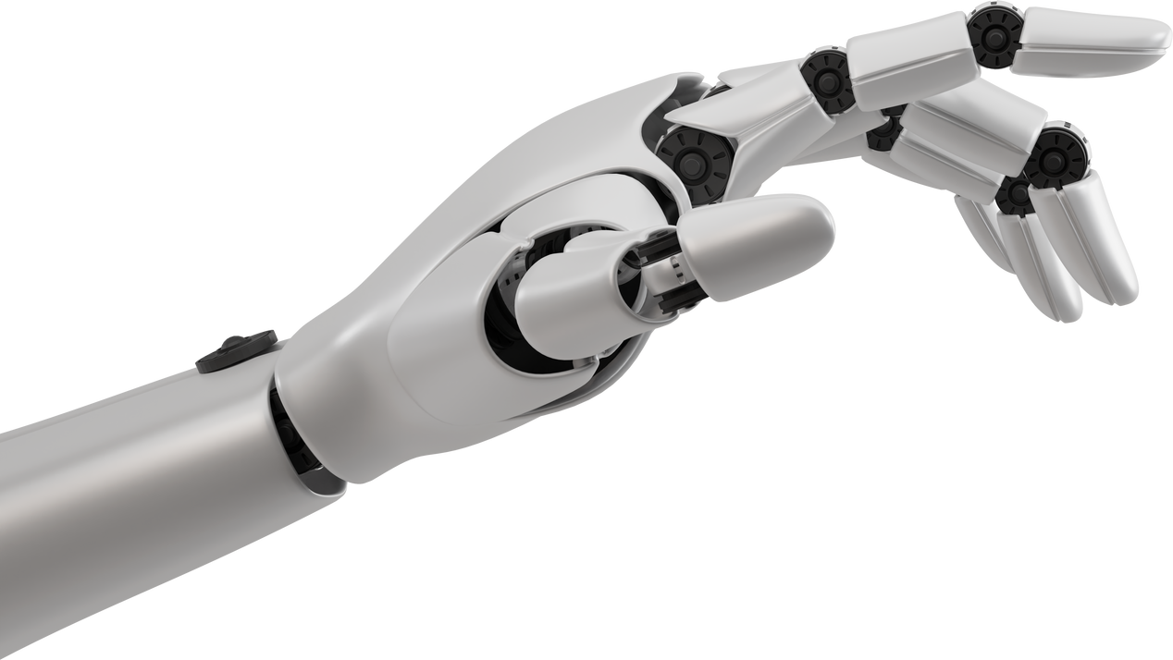
Solution : Main Feature
Buy or rent
AI recommendation
Cleaning service
partner
Notes:
We offer three key features: buying and renting management, along with AI recommendations. For instance, if a user buys a product for their newborn, our system notifies them and suggests products for the next stages of their child's development.

Slide 6
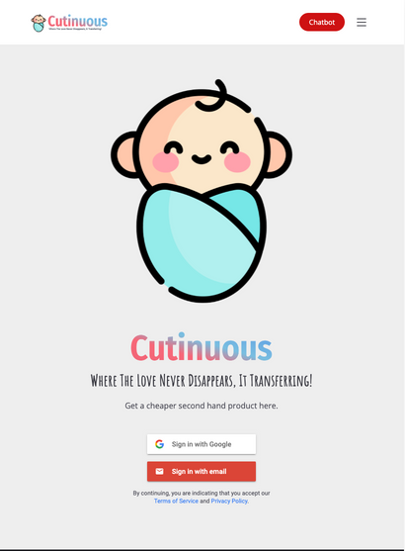

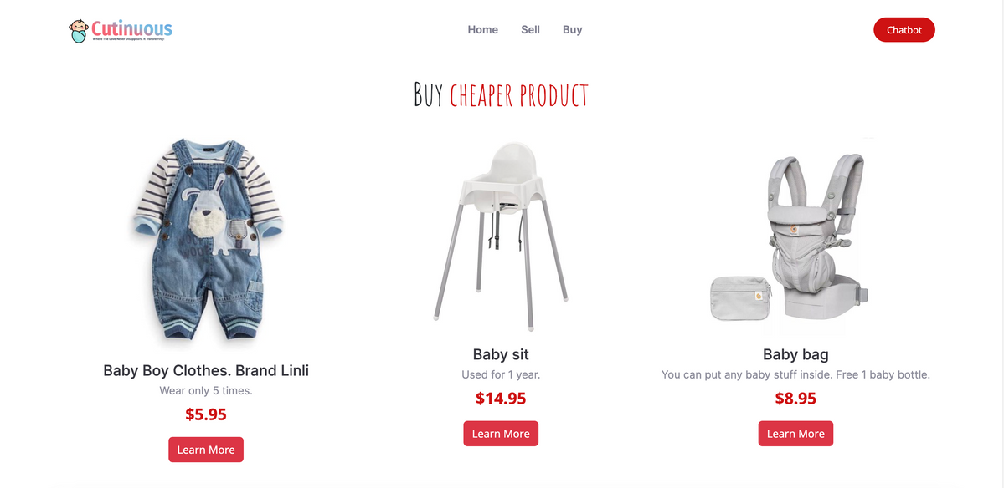








Solution : Demostration
https://cutinuous.web.app
https://cutinuous.jingjietan.com
Notes:
We developed a website which available for all platform. Feel free to scan and play along with us

Slide 7
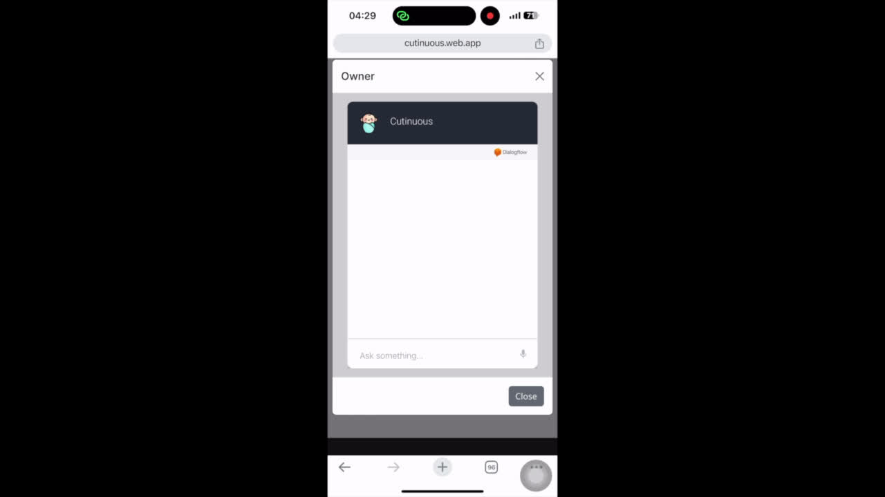
Solution : Video Demostration
Buyer
Notes:
Once logged in, users can browse and select products, such as a baby shirt. They can contact the owner for more details and also check the cleaning service options before proceeding with the deal.

Slide 8
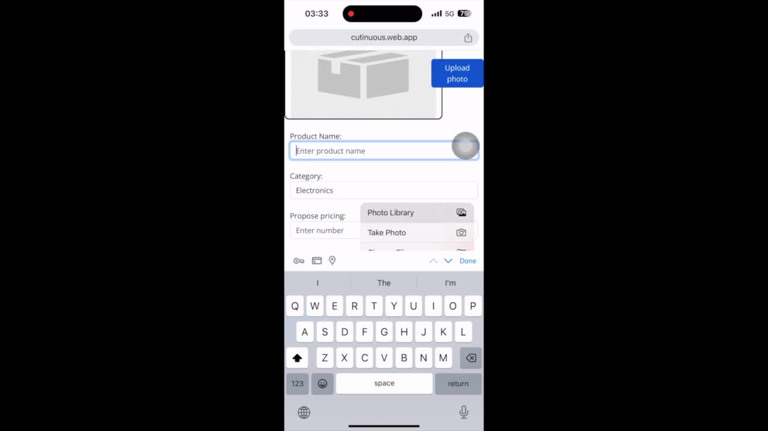
Solution : Video Demostration
Seller
Notes:
From seller perspective, they can upload a product, and put description on it.

Slide 9
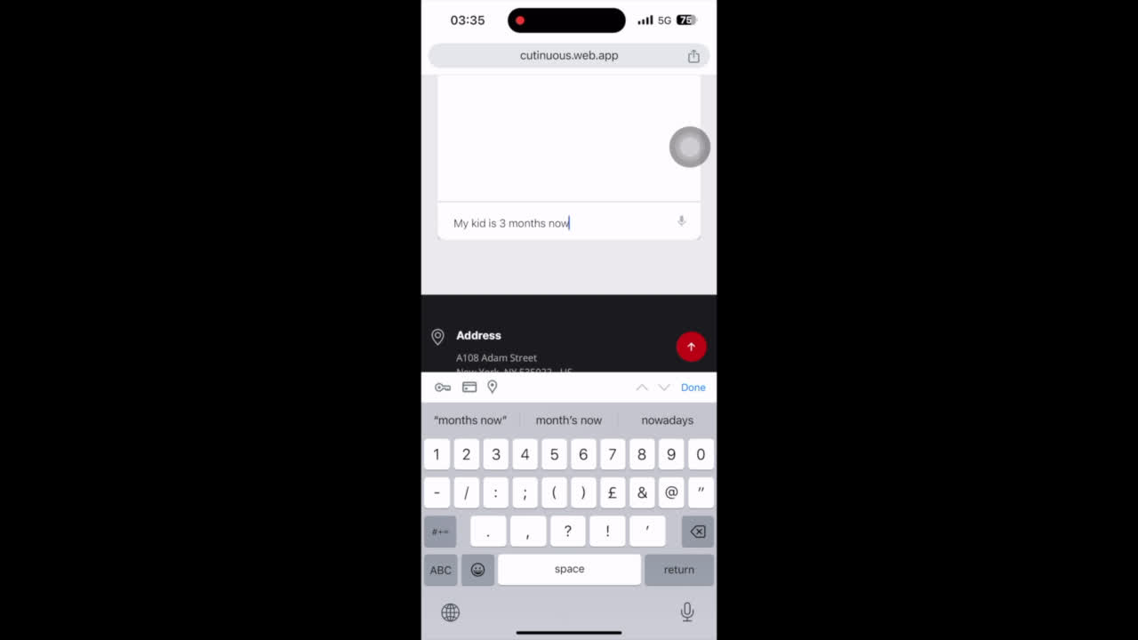
Solution : Video Demostration
Seller
Community welfare
Buyer
Notes:
We've integrated AI for product recommendations, navigation, and answering user queries.

Slide 10
Benefits of Solution
Seller
Buyer
Free their storage
Make money
Avoid advertisement
Save money
Gain recommendation
Pass the experience
Platform
Earn Commission
Notes:
In summary, our platform creates a win-win situation: sellers declutter and earn money from unused baby products conveniently, buyers save money with AI and owner recommendations, and we generate revenue while promoting a zero-waste society for baby products.

Slide 11



Revenue Stream
Commission Fees
Add-on Services
Advertisement
8% of the commission fees
Exp: Cleaning Service
Exp: In-app banners

Slide 12




Target group
BUYERS
SELLERS
Middle-class Income Level
Don’t know what to buy
Don’t have access to nearby shops for baby items
Don’t use the item anymore
Parents with multiple children
Parents who are active on social media
MOTHERS
PARENTS
Notes:
Adih

Slide 13
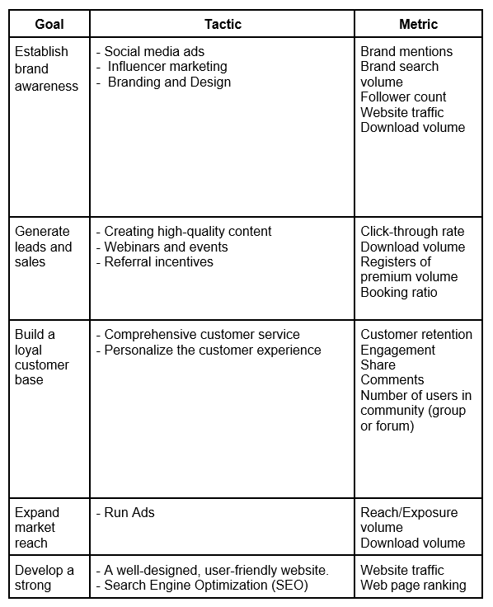
Marketing
Strategic Goals
Marketing Budget
% Revenue
Budget
Facebook Fanpage
TikTok Chanel
Year 1
40%
40%
40%
40%
Year 2
30%
30%
30%
30%

Slide 14

Market Size
TAM
$85.86 M
Baby clothes industry in Malaysia
SAM
$40.3 M
New family that are using second-handed baby clothes
SOM
$800k
New family that will buy second-handed baby clothes from “Cutinuousus”
Ref: https://www.statista.com/outlook/cmo/apparel/children-s-apparel/baby-clothes/malaysia#:~:text=Revenue%20in%20the%20Baby%20Clothes,(CAGR%202023%2D2028).
Notes:
Ooi

Slide 15



SDG Goal Achievement
11.1 RESPONSIBLE CONSUMPTION AND PRODUCTION
Reducing waste and promoting sustainable consumption aligns with creating more sustainable and resilient communities
1.2 REDUCE POVERTY
By providing affordable options for parents to access baby clothes, the platform can help reduce the financial burden on families, particularly those with lower incomes
12.2 REDUCE POVERTY
This platform encourages the reuse and resale of baby clothes, contributing to sustainable consumption and reducing waste.

Slide 16


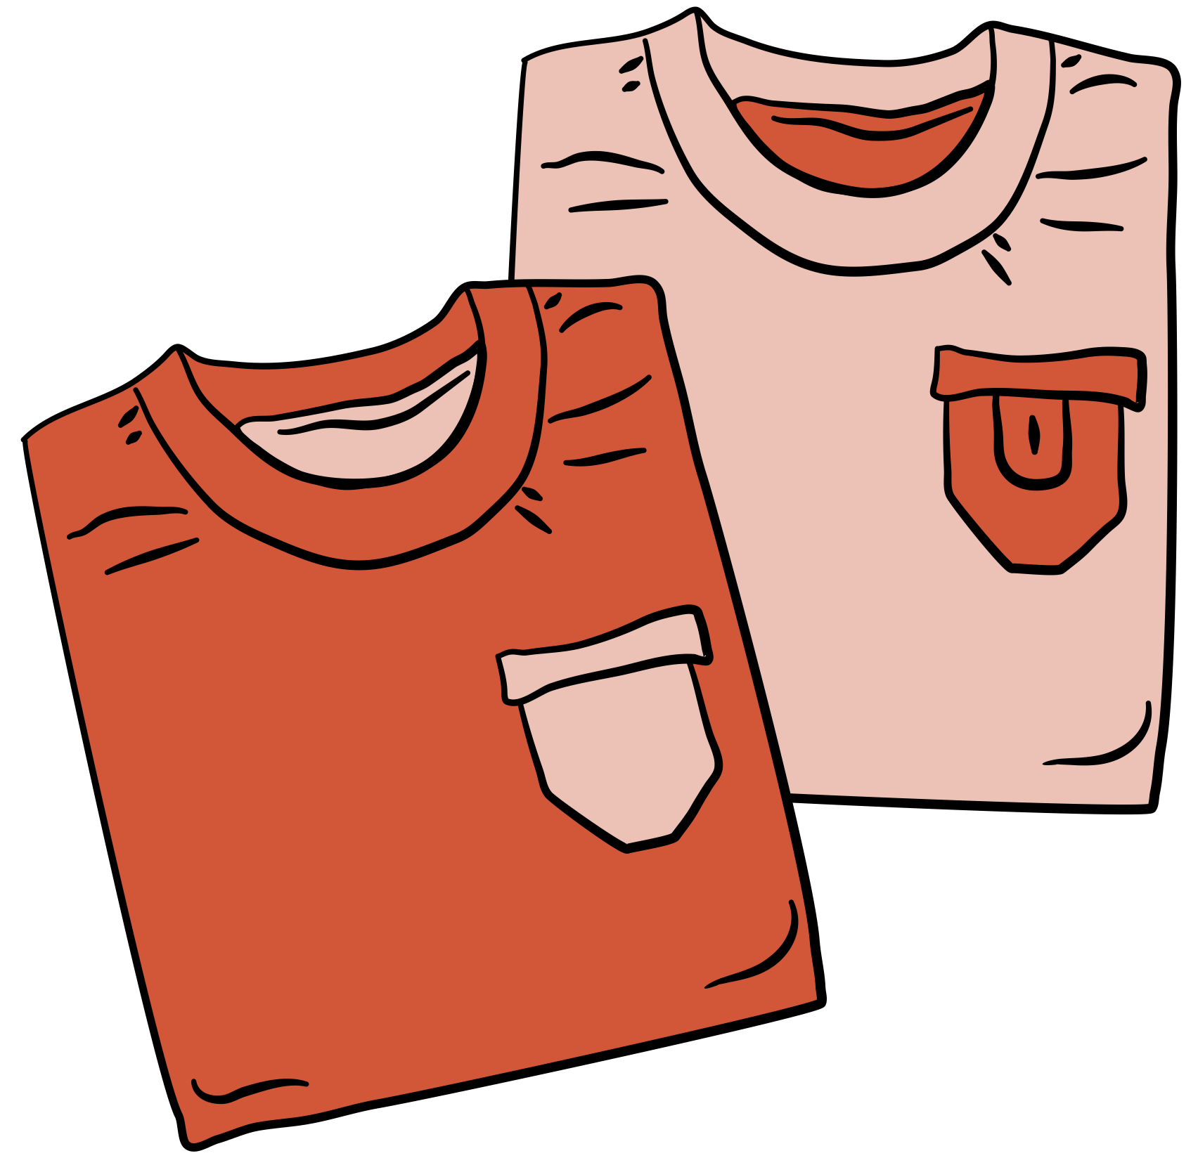
Potential Impact for the first year
Profits
People
Planet
$48k
20% Less
27,000
Gross Operating Profit
Apparel expenses
Pieces of Waste are Reused
Notes:
Potential Impact
Reduction of Waste: The platform helps reduce textile waste by facilitating the resale and reuse of baby clothes. They also extend the life cycle of these clothes and reduce the need for new production.
Affordable: Midle and Below midele class off people beside spend for stuff like clothes increase the pressure in spending for other demand
Sustainability: By encouraging the reuse of baby clothes, the platform aligns with sustainability goals. The textile industry's environmental impact is significant, and extending the life of clothing items can help reduce the carbon footprint.
Potential Challenges
Quality and Safety Assurance: Ensuring the quality and safety of secondhand baby clothes can be a challenge. Parents need to trust that the items they purchase meet safety standards and are in good condition.
Logistics and Shipping: Managing logistics, including the collection, storage, and shipping of baby clothes, can be complex, especially if the platform scales up. Proper storage and efficient distribution are essential.

Slide 17


Potential Challenge
Quality of Product
Authenticity

Slide 18
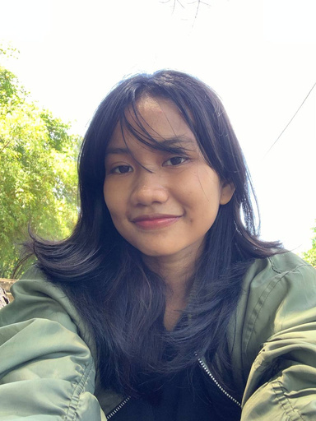
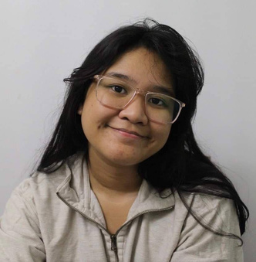
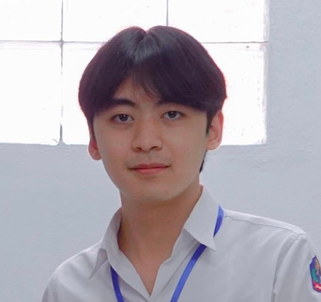
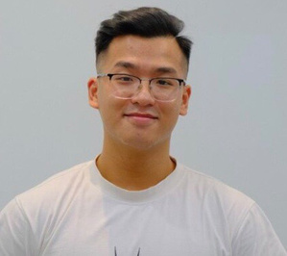
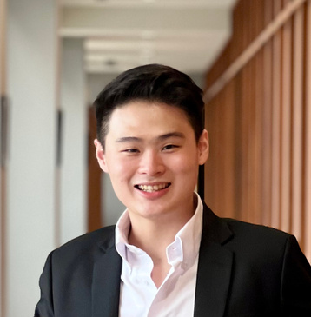
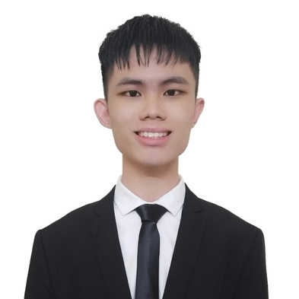






Our Team Members
Adhe
(Indonesia)
Mai
(Philippines)
Oui
(Laos)
Dat
(Vietnam)
Pao
(Thailand)
Jing Jie
(Malaysia)

Slide 19
Conclusion
Thank you
https://cutinuous.web.app
https://cutinuous.jingjietan.com

Slide 20
APPENDIX

Slide 21
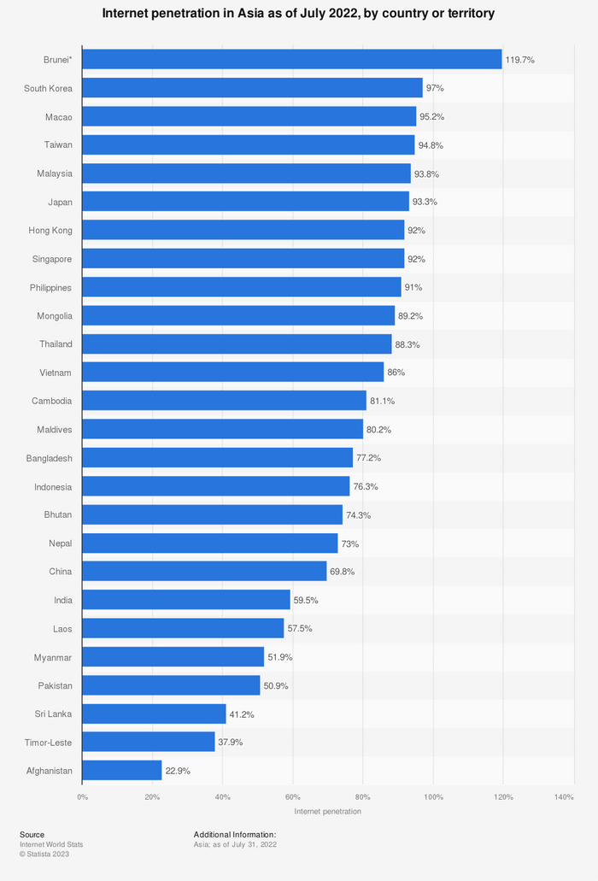
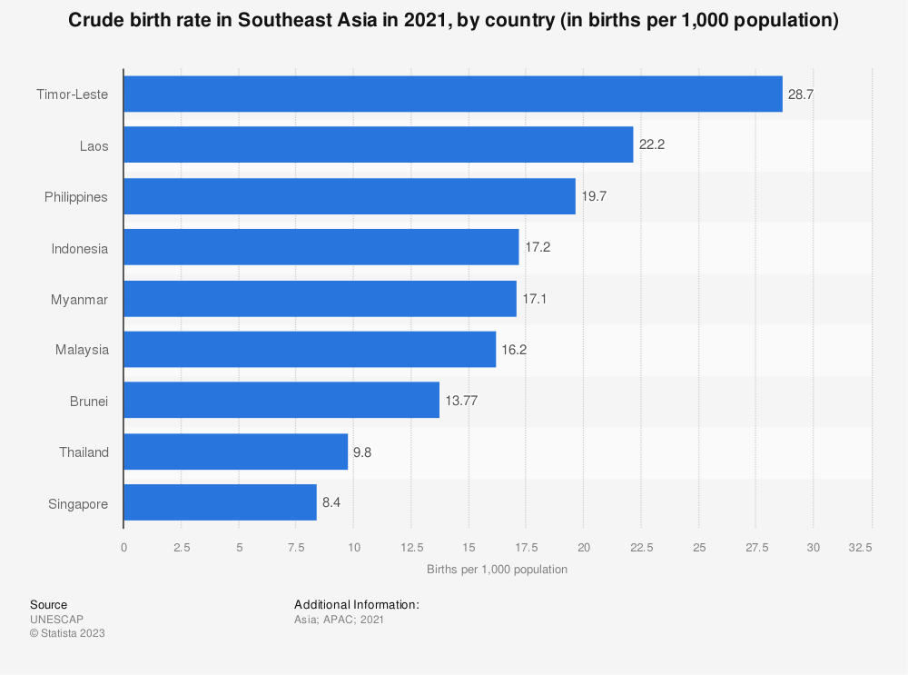

Slide 22
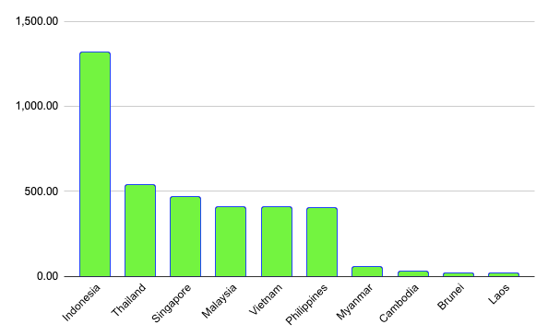

Slide 23
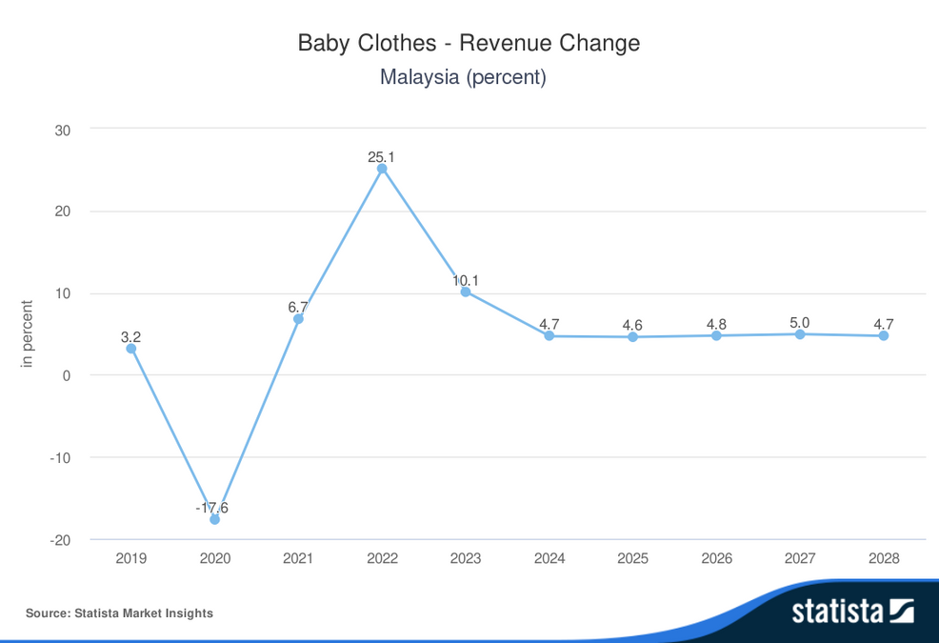
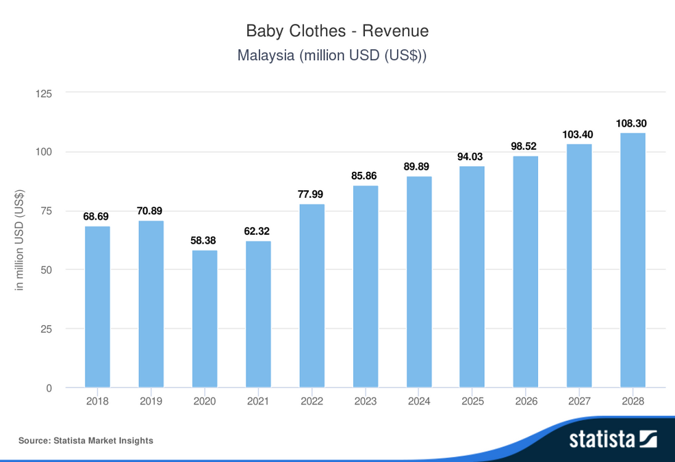

Slide 24
2023
2024
2025
2026
Initiate the website
MVP
Build a warehouse
Market penetration
Have 25%
Upgrade the platform
Have 30%
Start to penetrate to Indonesia
Have 8k users
Add new feature
Expand to international
market
Milestones

